Slide 1
Dr. Rose Sakamoto DrPH, CCRN, ANP-BC
Teresa Martin RN, Britney Nguyen RNc
Bridget Mattle RNc, Cindy Guzman RN
Jovanna Galindo RN, Rinin Wang RN

Slide 2
Robust Aging Program: The Vision
01
02
03
04
Dr. Sakamoto: SON engagement with the aging population
Partnership: OLLI
Osher Life Long Learning Institute at CSUF
Services: Clinic
Education: Gero Nursing
Basic First Aid
Referrals and resources
BP Checks, Health Assessments
Medication counseling
Vitamin D Study
On-line education seminars
Notes:
teresa

Slide 3
INTRODUCTION
The Purpose:
Provide basic health assessment and community resources
Promote healthy behaviors to minimize chronic conditions through education
Why this is important in the SON?
As the number of older adults in our community continues to grow, the SON has a responsibility to provide resources including assessment and health information to promote robust aging among this population.

Slide 4
SCHOOL OF NURSING STUDENTS
Opportunity :
Serve as a practicum/internship
for undergraduate and graduate
nursing students
Psychosocial & physical assessment skills
Exploration of health care resources
Medication review

Slide 5
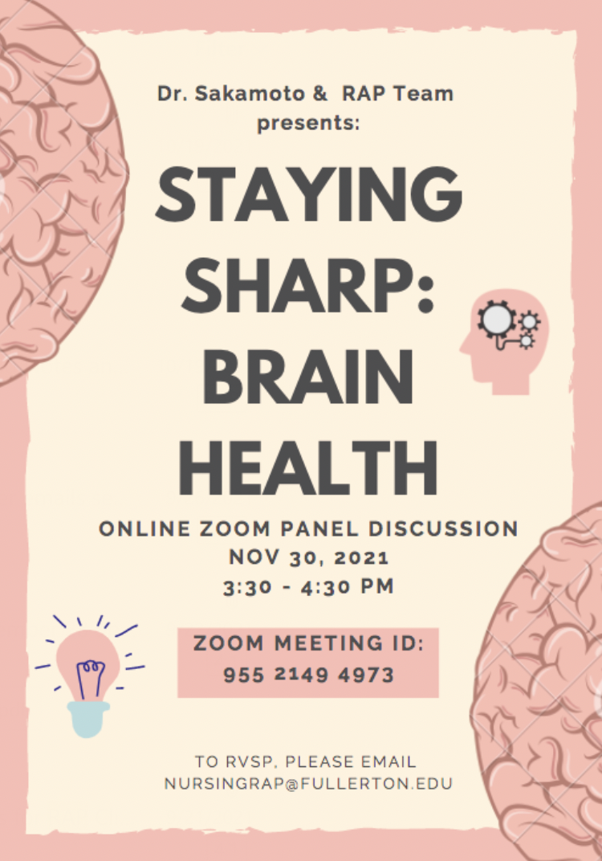
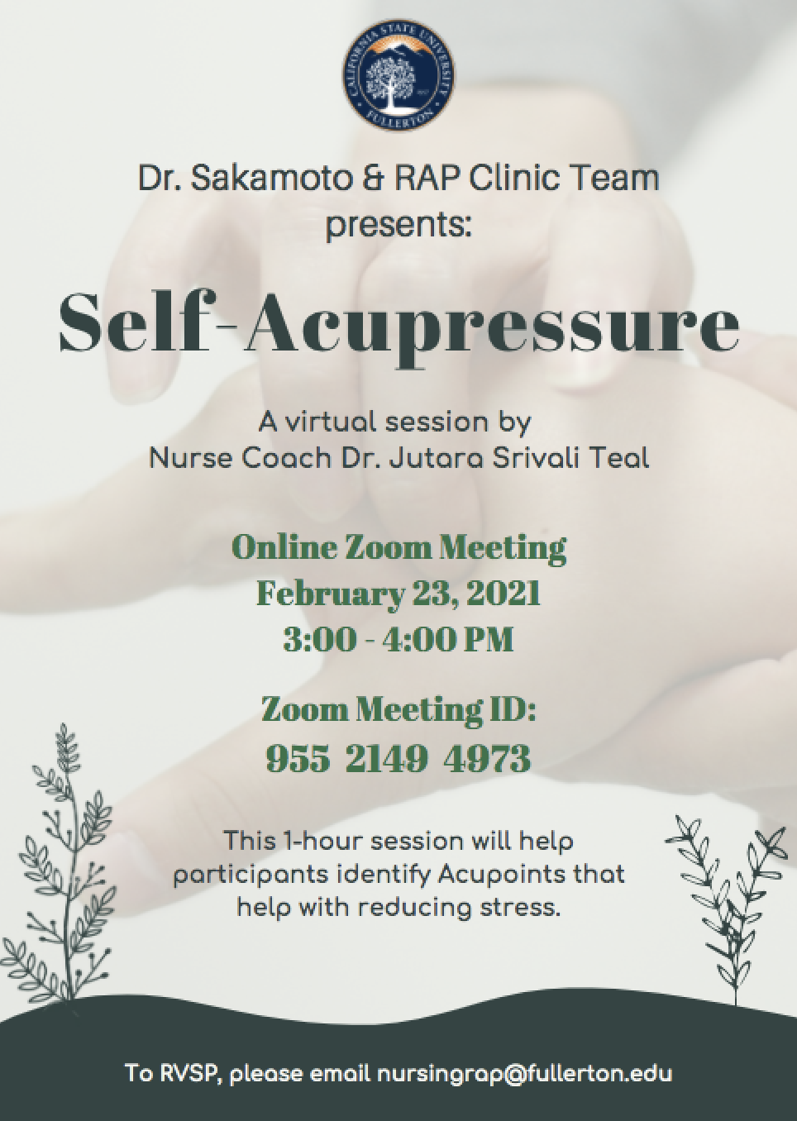
RAP CLINIC'S PAST EVENTS
Notes:
Britney
Since the pandemic started, the RAP Clinic had to transition from being a full-functioning in-person clinic to that on Zoom. Because it was difficult to gather participants on Zoom, especially since many of our OLLI members are of older age, the RAP Team of Fall 2020 ultimately made the decision to create educational sessions and informational events to teach about health prevention and promotion. We've added some flyers from previous events we have held.
These educational sessions have been hosted by Dr. Sakamoto and other professors and CSUF SON staff/faculty. These all have been held on Zoom in which a PPT is shared and participants engage in activities to demonstrate their knowledge. Our largest event had over 60 participants who logged into Zoom. This includes OLLI members, CSUF staff/faculty, and even students.
These events back the clinics' purpose by motivating older adults to engage in healthy behaviors to minimize chronic conditions through education and other resources.
*READ OFF NAMES OF EVENTS*

Slide 6
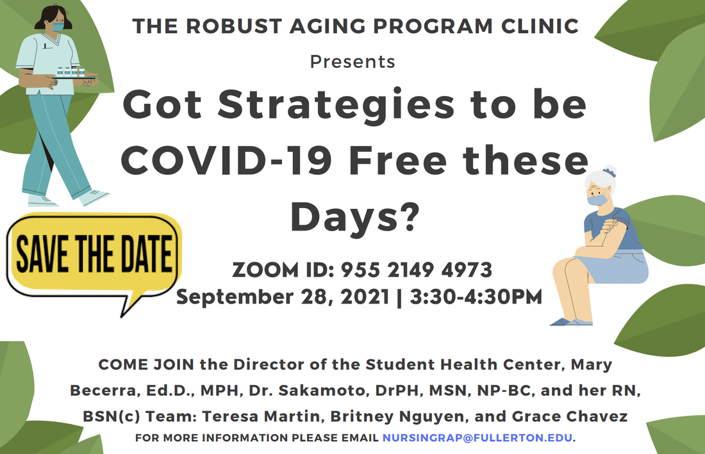
RAP CLINIC'S PAST EVENTS
Notes:
Britney
Here are some more flyers that we made
*READ OFF NAMES OF EVENTS*

Slide 7
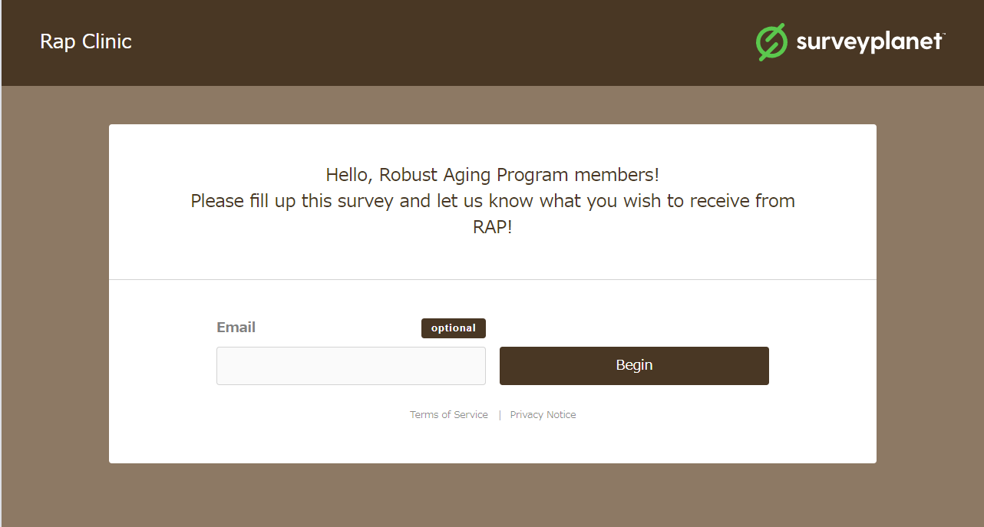
SURVEY
LINK: https://s.surveyplanet.com/duan32cu

Slide 8
Why Web?
For the last two years, social distance communication is a practice that has become the normal way to give and receive information in society. We understand that going back to face-to-face can still feel scary due to not knowing where we stand with COVID. We want to provide a website that offers a way to promote wellness and transition into a technological approach to communication with the RAP healthcare team. Our RAP volunteers have a strong love for the gerontology community, and we want to provide online resources for health and wellness.
>
Notes:
Cindy

Slide 9
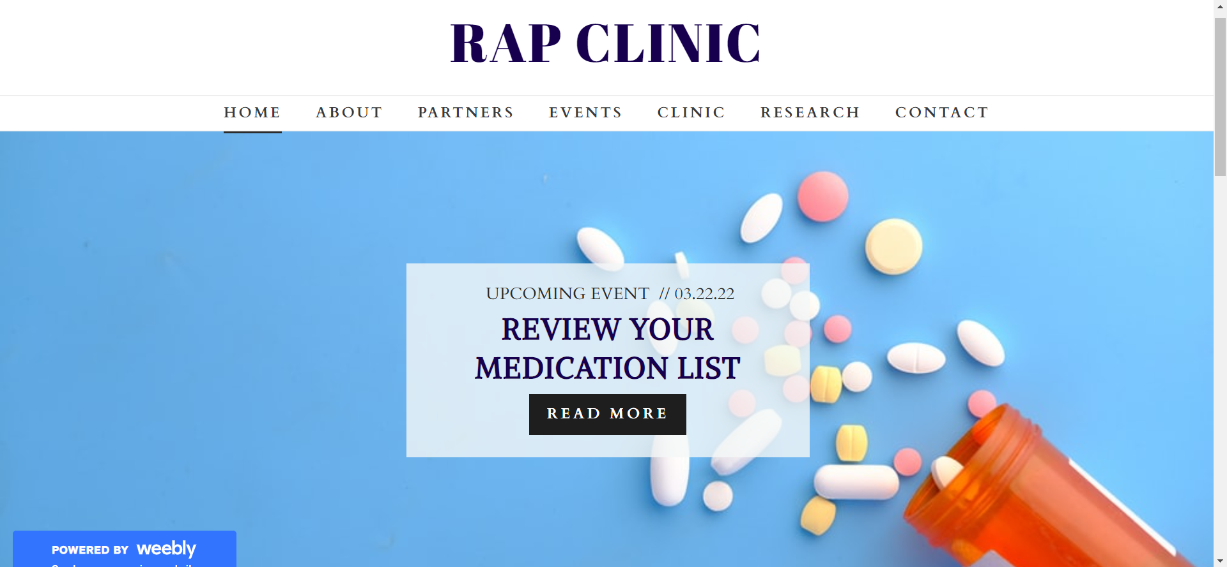
WEB SITE HOME PAGE
LINK : https://rapclinic.weebly.com/

Slide 10
Come volunteer for Fall '22!
THANKS!

Slide 11
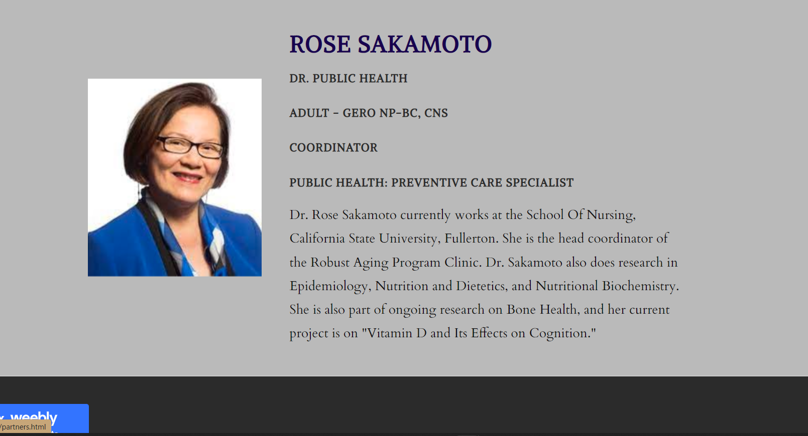
RAP COORDINATOR

Slide 12
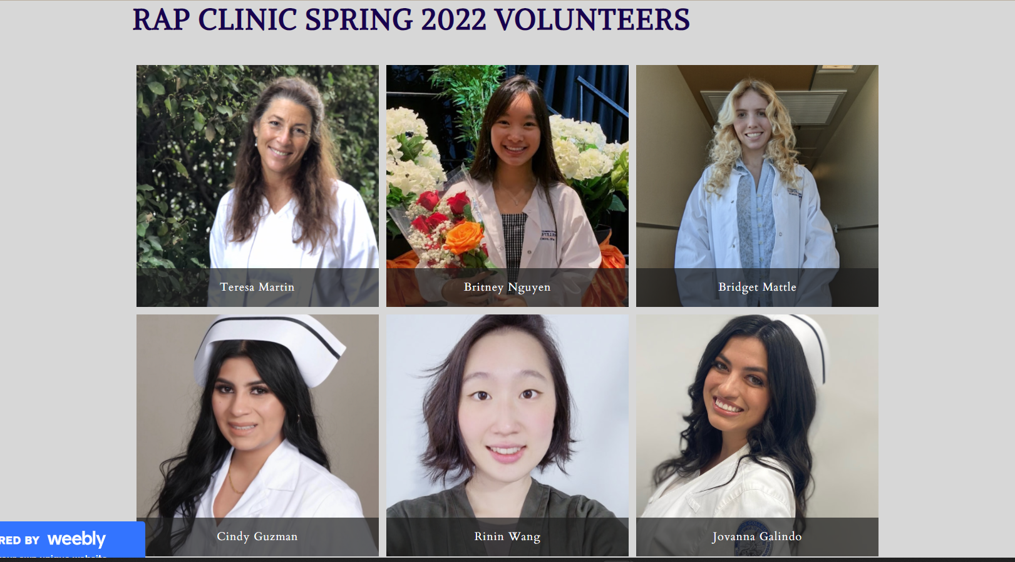
MEMBERS

