Slide 1
Self-acupressure as Self-care for Stress and Fatigue
Jutara Srivali Teal, DNP, MTOM, RN, L.Ac., NC-BC
Assistant Professor
CSU Fullerton

Slide 2
Objectives
At the end of this presentation, participants will be able to:
Identify Acupoints that are calming and Acupoints that are energizing
Verbalize the benefit of self-acupressure
Demonstrate accurate self-acupressure

Slide 3
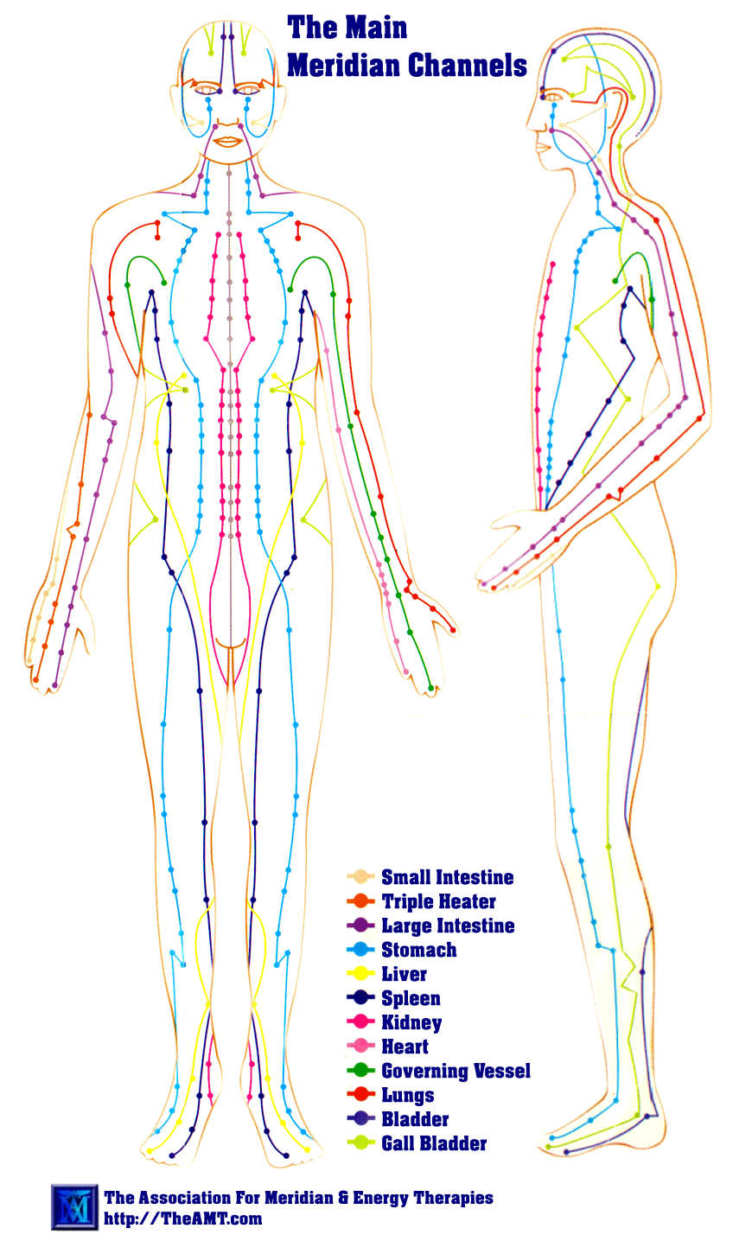
Acupoints

Slide 4
Principles
Activation of Qi (Chee)
Used a part of the system balance
Self-acupressure is not intended to cure any ailments
Theories and styles may vary
*CAUTION: If you bruise easily due to taking blood thinners,
do not use pressure that may cause bruising.

Slide 5
Heart 7
Heart 7, also known as Shen men (which translates to “Spirit Gate”)
Known for its calming quality and is helpful for stress that affects the heart (e.g., emotional or increased heart rate).
This acupoint can be used as needed throughout the day.
Heart 7 is on the Heart Meridian, which travels from the axillae proximally to the distal part of the fifth digit on the medial side of the arm.

Slide 6
Heart 7
To locate Heart 7, open the hand and turn the palm upwards. The acupoint is between the bone of the hand and the tip of the bone of the arm
Using the thumb or the index fingertip to apply moderate pressure to Heart 7 for 10 – 15 seconds, release for 5 seconds, and repeat for 3 minutes.
An alternate method is rubbing Heart 7 in a small back and forth proximally and distally for the same duration.

Slide 7
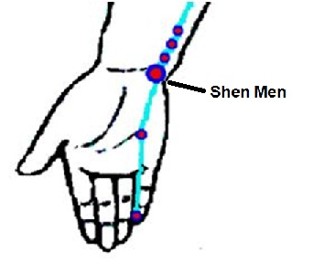
Heart 7

Slide 8
Yintang
Yintang (Hall of Impression) is known as the third eye or Ajna chakra.
Yintang is used for calming and helping with focus.
The Yintang acupoint is not on a meridian.

Slide 9
Yintang
Yintang is located at the midpoint between the eyebrows.
Use the index finger to apply light pressure.
Apply pressure on Yintang for 10 – 15 seconds, release for 5 seconds, and repeat for 3 minutes.
An alternate method is lightly massaging Yintang in a small clockwise circle for 2 - 3 minutes.

Slide 10
Yintang
Yintang is generally calming.
Yintang also helps with stress associated with a lack of mental focus.
Applying pressure to Yintang can prompt taking slow, deep breaths.
The rationale for this phenomenon is unclear
This acupoint can be used 2 – 3 times a day as needed.

Slide 11
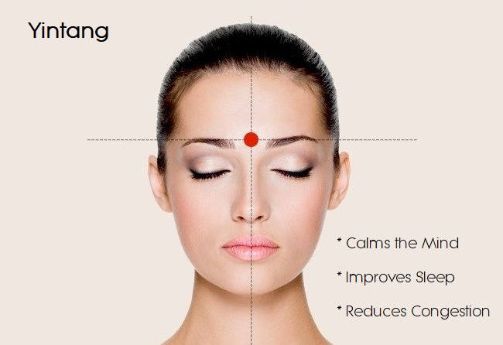

Slide 12
Shen ting
Du 24 is also known as Shen ting (translates to “spirit courtyard”). Du 24 is calming and uplifting, as if in a relaxing garden courtyard.
Method: The Du 24 point is just inside the middle of the anterior hairline.
Apply pressure for 10 – 15 seconds, release for 5 seconds, and repeat as needed for 3 minutes.
Effects: Du 24 is good for stress associated with sadness.

Slide 13
Du 24

Slide 14
Wan Gu
Wan Gu (translated to “Completion Bone”)
Useful for stress accompanied by neck tension
Wan Gu is also known as Gallbladder 12
Located behind the ear, below the corner of the skull bone

Slide 15
Wan Gu

Slide 16
Energizing points
CAUTION:
Acupoints:
Large Intestine 4 and Spleen 6 are not to be used in Pregnant individuals

Slide 17
Large Intestine 4
Large intestine 4, also known as He Gu (which translates to “Converging Valley”).
Large intestine 4 is a popular acupoint for its reputation for treating pain.
Large intestine 4 has many indications, and its property of being a vital energy point makes it an important point for energy when combined with other energizing acupoints.

Slide 18
Large Intestine 4
Large intestine 4 is on the back side of the hand, in the wedge between the thumb and index finger
Place the opposite thumb on the Large intestine 4 acupoint and the index finger on the palm side of the hand to support the pressure applied by the thumb.
This point is often sensitive. Squeeze the acupoint lightly.
Lightly massaging this acupoint can be comforting.

Slide 19
Large intestine 4
Large intestine 4 is a good point for fatigue
accompanied by a dull headache or
related to constipation or
fatigue related to stress.

Slide 20
Large intestine 4

Slide 21
Zu San Li
Stomach 36, known as Zu San Li (translates as “Leg Three Miles”).
In ancient times, Stomach 36 is used to give a person enough energy to walk for three more miles.
Stomach 36 is known for its energy-boosting quality.
Stomach 36 has multiple indications, including
General gastrointestinal discomforts,
Leg weakness,
Supporting general health.

Slide 22
Zu San Li
Use the hand on the same side to align the index finger to the bottom border of the kneecap.
The pinky finger will be at the level of Stomach 36
Stomach 36 is just on the outer side of the shinbone
The point feels like it is dent

Slide 23
Zu San Li

Slide 24
Spleen 6
Spleen 6, known as San yin jiao (translates as “Three Yin Intersection”).
Location:
Use the opposite hand to locate Spleen 6 on the opposite leg
Align the pinky finger with the level of the medial malleolus;
Spleen 6 is at the level of the index finger next to the shinbone.
The point feels like a slight indentation
Spleen 6 is often tender to moderate pressure, especially for those who walk a lot

Slide 25
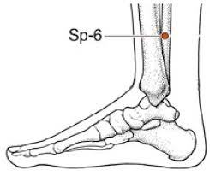
Spleen 6
In theory, stimulating Stomach 36 and Spleen 6 helps support overall energy balance.
As a single acupoint, Spleen 6 can alleviate
Primary dysmenorrhea and premenstrual syndrome and induce labor
Sleeplessness related to menopause

Slide 26
Bai Hui
Du 20, known as Bai Hui (translates to “Hundred Convergences”).
It is the highest acupoint on the body.
Theoretically, Bai Hui pulls the body’s energy upwards.
Locate Bai Hui
Place the index fingers on the highest point of the ear and draw an imaginary line to the top of the head.

Slide 27
Bai Hui
Good point for fatigue associated with
a heavy sensation,
overactive thoughts, stress,
feels of being pulled downwards.
However, if there is excess energy, the point can also have calming effects.

Slide 28
Du 20

Slide 29
References
Andrews, H., Tierney, S., & Seers, K. (2020). Needing permission: The experience of self-care
and self-compassion in nursing: A constructivist grounded theory study. International
Journal of Nursing Studies, 101, 103436–103436. https://doi.org/10.1016/j.ijnurstu.2019.103436
Baskan, S. A. & Tan, M. (2020). Effect of acupressure on fatigue in patients with chronic obstructive pulmonary disease.
International Journal of Caring Sciences, 13(2), 804–811.
Cho, Y., Joo, J.-M., Kim, S., & Sok, S. (2021). Effects of meridian acupressure on shiftwork nurses' stress, fatigue, anxiety, and
self-efficacy in South Korea. International Journal of Environmental Research and Public Health, 18(8), 4199–.
https://doi.org/10.3390/ijerph18084199
Derya Ister, E. & Altinbaş, Y. (2022). The effect of acupressure on anxiety and pain among patients undergoing coronary angiography: A randomized controlled trial. Holistic Nursing Practice, 36(6), E57–E63. https://doi.org/10.1097/HNP.0000000000000553
Duan, G., Chen, Y., Pang, Y., Feng, Z., Liao, H., Liu, H., Zou, Z., Li, M., Tao, J., He, X., Li, S., Liu, P., & Deng, D. (2021).
Altered fractional amplitude of low-frequency fluctuation in women with premenstrual syndrome via acupuncture at Sanyinjiao (SP6). Annals of General Psychiatry, 20(1), 29–29. https://doi.org/10.1186/s12991-021-00349-z

Slide 30
References
Hsieh, S.-H., Wu, C.-R., Romadlon, D. S., Hasan, F., Chen, P.-Y., & Chiu, H.-Y. (2021). The effect of acupressure on relieving cancer-related fatigue: A systematic review and meta-analysis of randomized controlled trials. Cancer Nursing, 44(6), E578–E588. https://doi.org/10.1097/NCC.0000000000000997
Kanza Gul, D. & Solt Kirca, A. (2020). Effects of acupressure on preoperative acute anxiety in cesarean section under spinal anesthesia. Holistic Nursing Practice, 34 (6), 356-364. https://doi.org/10.1097/HNP.0000000000000413.
Khanghah, A.G., Rizi, M. S., Nabi, B. N., Adib, M., & Leili, E. K. N. (2019). Effects of acupressure on fatigue in patients with cancer who underwent chemotherapy. Journal of Acupuncture and Meridian Studies, 12(4), 103–110.
Kwon, C.Y. & Lee, B. (2018). Acupuncture or acupressure on Yin tang (EX-HN 3) for anxiety: A preliminary review. Medical Acupuncture, 30(2), 73–79. https://doi.org/10.1089/acu.2017.1268
Ma, Q. (2020). Somato-autonomic reflexes of acupuncture. Medical Acupuncture, 32(6), 362–366. https://doi.org/10.1089/acu.2020.1488
National Comprehensive Cancer Network (2023). Clinical Practice Guidelines in Oncology (NCCN
Guidelines®) Cancer-related fatigue. https://www.nccn.org/professionals/physician_gls/pdf/fatigue.pdf. Retrieved May 20, 2023.

